Slide 1



Business Etiquette - 1

Slide 2
Preface
In today's globalized world, building strong business relationships is crucial. Understanding and practicing business etiquette is an essential skill that can help you navigate professional interactions and achieve success.
This presentation will explore the key components of business etiquette, including values, manners, customs, language, and tradition.
By understanding these elements, you can present yourself professionally, build trust with colleagues and clients, and ultimately achieve your business goals.

Slide 3
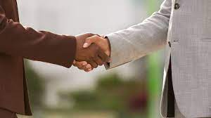

Business etiquette
Business etiquette is a set of unwritten rules or expectations that govern how professionals interact with each other in the workplace and business settings.
It's essentially a code of conduct that ensures respectful, smooth, and productive interactions.
By understanding and practicing business etiquette, you can create a positive impression, build trust with colleagues and clients, navigate professional interactions with confidence, and ultimately achieve your business goals.

Slide 4
Core Values in Business Etiquette
Respect: Treat everyone with dignity and courtesy, regardless of their position.
Honesty: Be truthful and transparent in your communication.
Integrity: Uphold ethical principles and act with fairness.
Reliability: Be dependable and fulfill your commitments.
Professionalism: Maintain a composed and appropriate demeanor in all situations.

Slide 5
Significance of Incorporating Cultural Sensitivity
These core values form the foundation of good business etiquette. By demonstrating these values, you show others that you are trustworthy, responsible, and someone they can rely on.
This fosters positive working relationships and creates a climate of mutual respect.

Slide 6
Mind Your Manners: Business Etiquette in Action
Punctuality: Arrive on time for meetings and appointments.
Professional attire: Dress appropriately for the workplace and business interactions.
Body language: Maintain good posture, make eye contact, and avoid fidgeting.
Active listening: Pay close attention to what others are saying and ask clarifying questions.
Gratitude: Express appreciation for others' time and contributions.

Slide 7
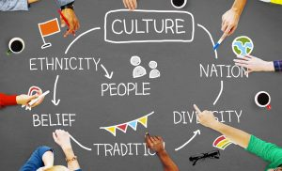
Cultural Awareness
The world of business is global, so understanding cultural differences is crucial:
Research customs: Before traveling for business, research greetings, gift-giving practices, and table manners in the country you're visiting.
Respectful communication: Avoid humor or topics that may be offensive in other cultures.
Dress modestly: Be mindful of attire in conservative cultures.
Patience and Adaptability: Be prepared to adapt your approach to business etiquette based on the cultural norms of your colleagues and clients.

Slide 8
Impact of Culture on Business Practices
Elevates performance through shared energy, enthusiasm, commitment and collaboration.
Stabilises disparate effort across the business, balancing out the thousands of behaviours that occur every day across your organisation, into one directive group effort.
Delivers your brand promise.
Turns a person into a people, turning the perception of ‘I’ into ‘We’.
Enables shared meaning to be drawn from the work we do and makes our combined efforts worthy of our best efforts.

Slide 9
Impact of Culture on Business Practices
Supports the delivery of customer service experiences.
Delivers your business strategy.
Creates the environments, daily rituals and beliefs that connect your people, with your company.
Culture is the context in which leadership must operate, influence and inspire.

Slide 10
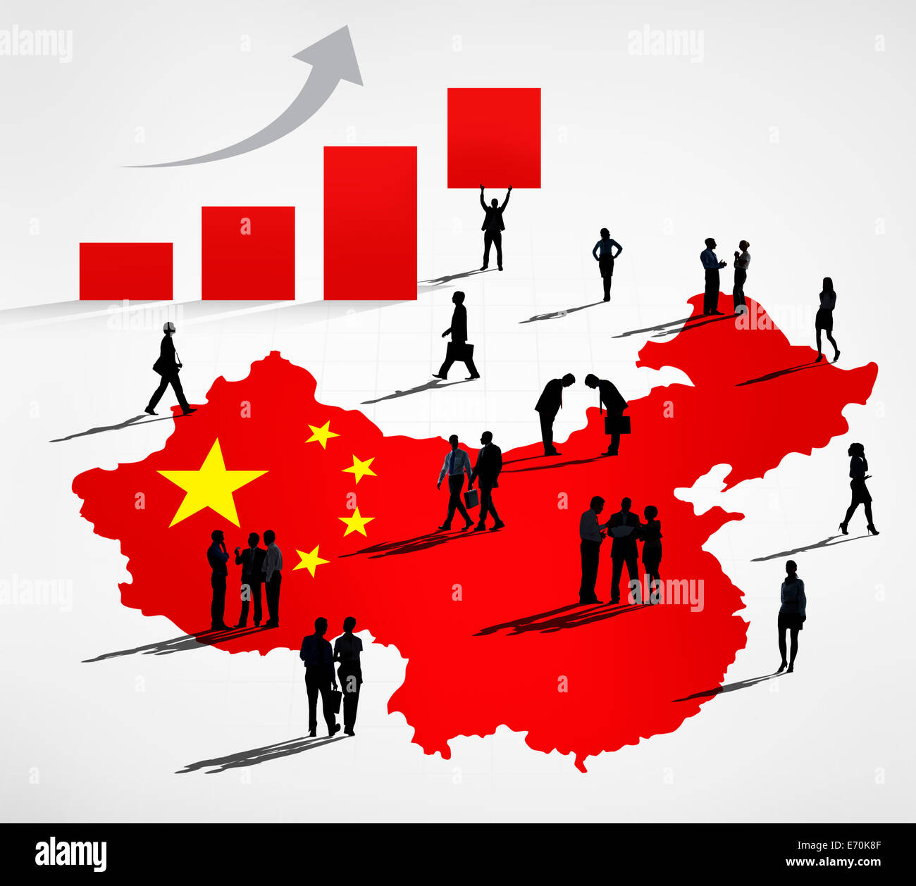
Business Etiquette around the World-CHINA
Show up on time for business meetings. Punctuality is important to the Chinese and being late is offensive.
Chinese people appreciate a conservative dress code, and you should avoid physical contact while conversing.
Always be prepared for meetings. Conduct research on the company ahead of time and avoid scheduling a meeting during a Chinese holiday.
Enter the room in hierarchical order. The person of the highest seniority will enter the room first and the rest will follow in order.

Slide 11
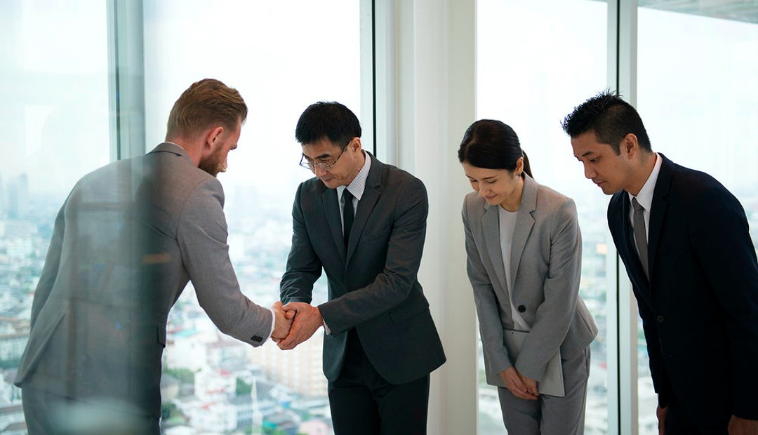
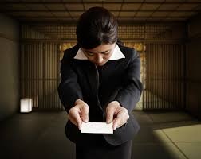
Business etiquette: Japan
Bowing is a typical way of greeting each other. Handshakes sometimes occur, but you should let the Japanese person initiate it.
The senior member of the group often leads the business meeting while younger members, out of respect, speak less. People of similar positions in different groups should sit across from each other; junior employees should never sit across from senior employees.
When handing out business cards, make sure you’re using both hands. Bowing during this exchange is viewed as a form of respect.

Slide 12
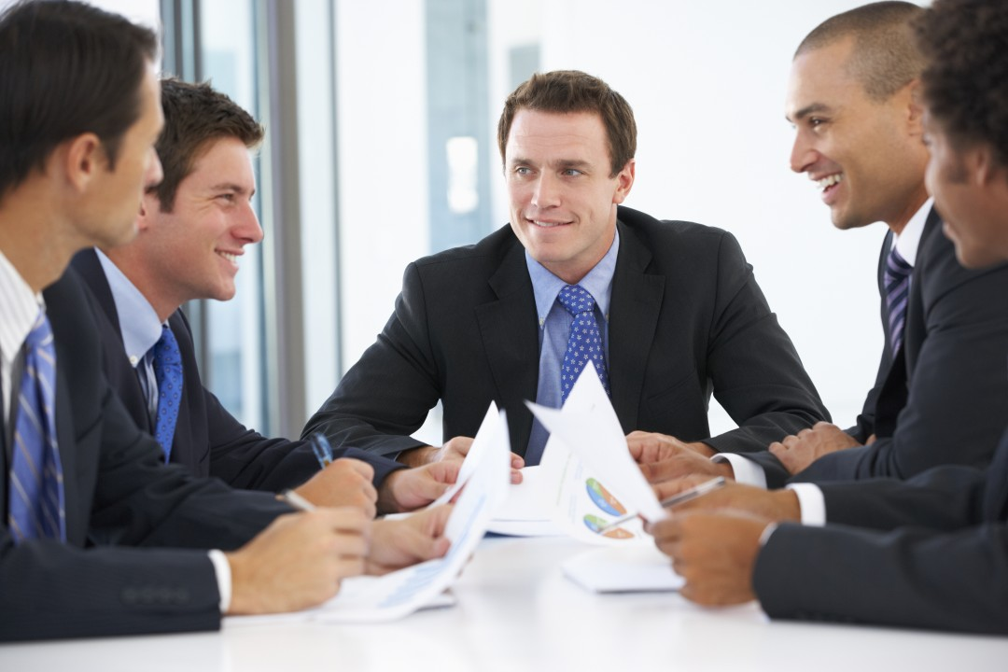
Business etiquette: France
It is vital to make appointments for both business and social occasions. It is not acceptable in France to drop in on someone unannounced.
Punctuality is valued but sometimes treated casually in France, so do not be surprised if your French colleague arrives late
As you would expect, the nation that created haute couture puts a premium on style. Fashion and appearance are more important in France than in many other countries in the world.
Even low-paid, entry-level executives buy the best clothes they can afford. Dress tends to be on the formal side for both men and women, whether in business or social situations.

Slide 13
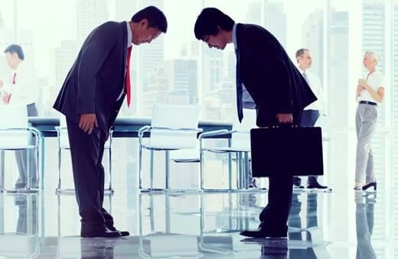

Traditional Customs in Business
Incorporating Local Traditions into Business Practices
Embracing Cultural Celebrations

Slide 14
Traditions and Business: Embracing the Past for Future Success
Business traditions vary from industry to industry and company to company. Understanding these traditions can give you valuable insights into the company culture and how business is conducted.
Respecting traditions demonstrates your willingness to integrate into the company and builds trust with colleagues.
However, it's also important to be adaptable. Some traditions may no longer be relevant, so be prepared to adjust your approach if necessary.

Slide 15
Business Etiquette in the Digital Age:
The rise of digital communication requires new considerations for etiquette:
Professional Online Presence: Maintain professionalism in all online interactions, including email, social media, and video conferencing.
Social Media Awareness: Be mindful of what you post on social media, as it can impact your professional image.
Email Etiquette: Use proper email etiquette, including clear subject lines, professional greetings, and avoiding excessive exclamation points.
Confidentiality: Be cautious about sharing confidential information online.
Prompt Response: Respond to emails and messages promptly to show respect for others' time.

Slide 16
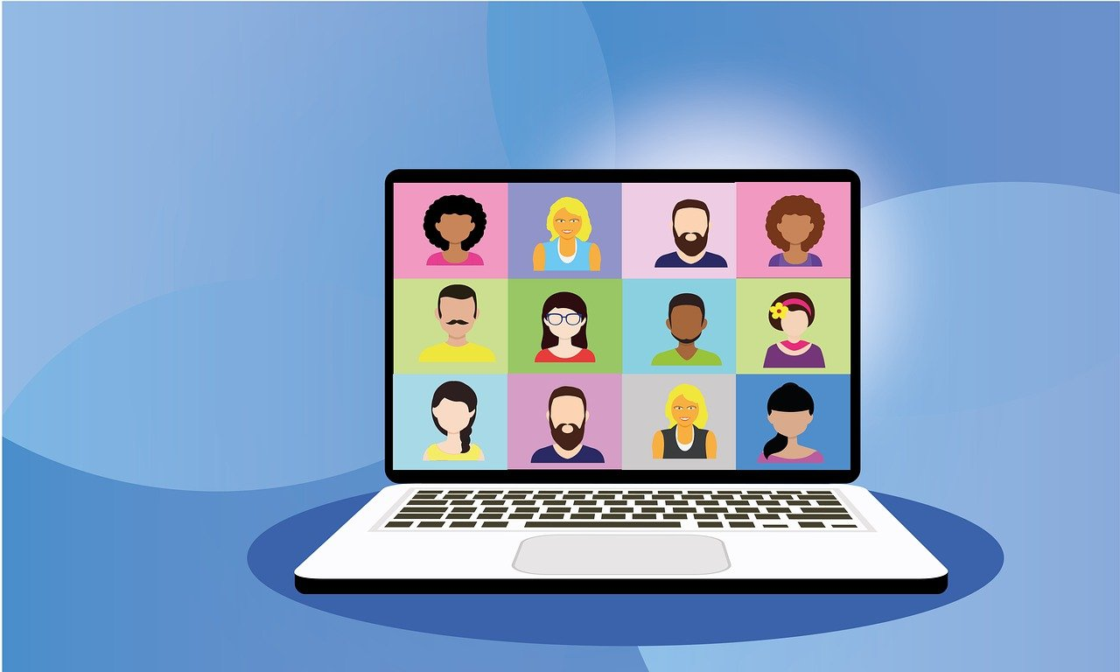
Technology and Virtual Etiquette
Navigating Video Conferencing and Virtual Meetings
Adapting to Online Communication Norms

Slide 17
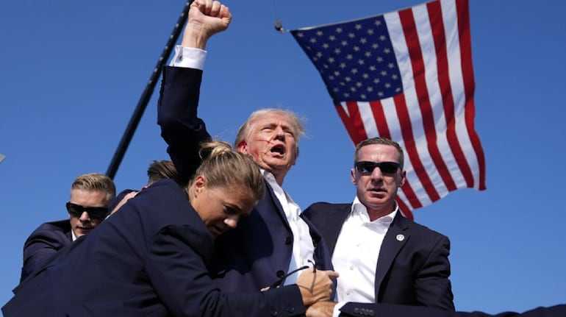
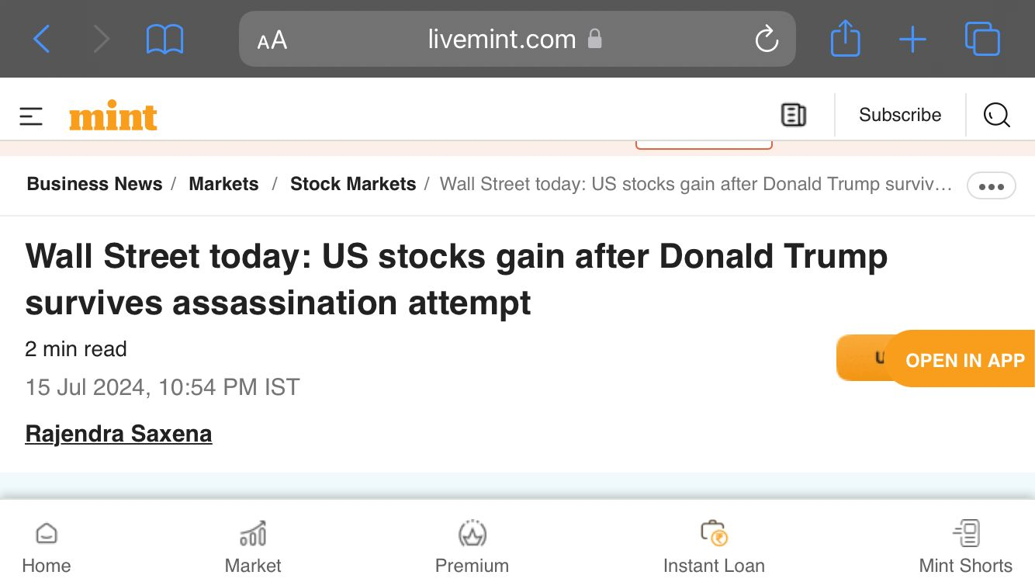
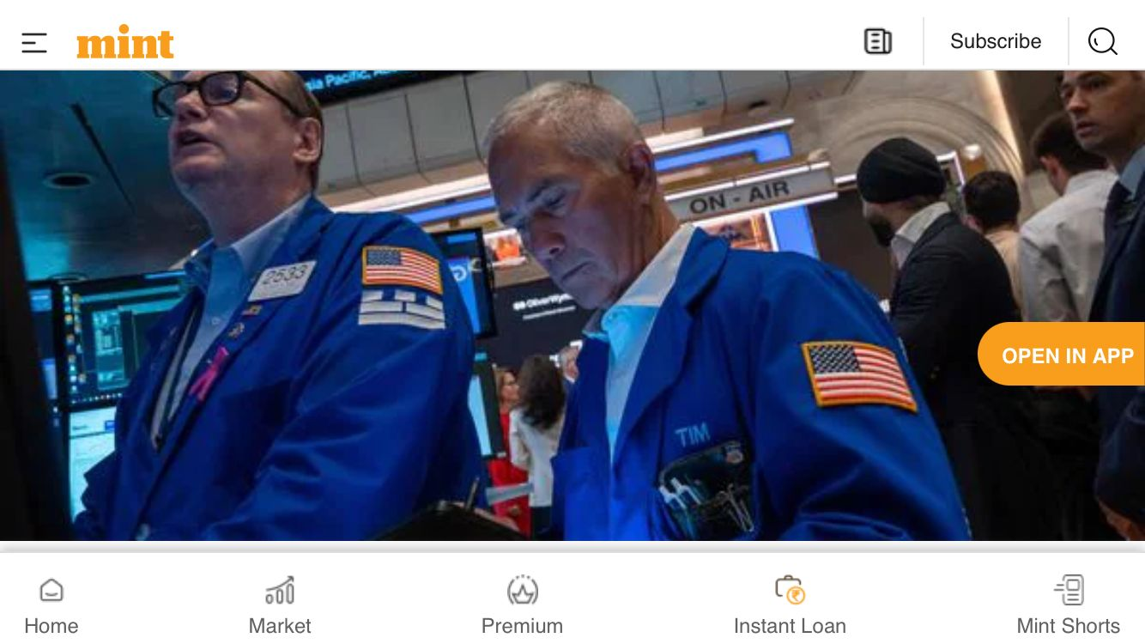
How an assassination attempt of a Person have an impact over Business around the world.

Slide 18
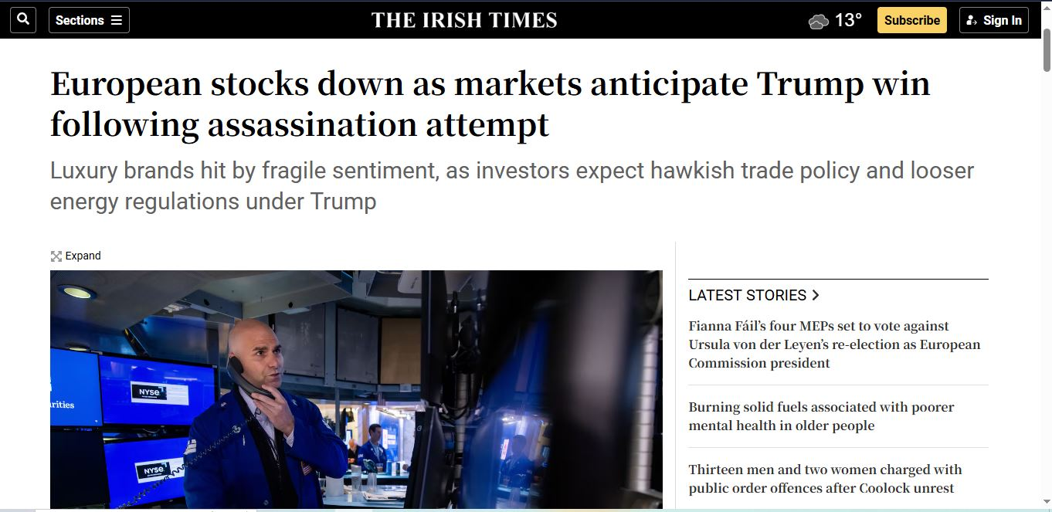

Slide 19

QUESTION 1
Which of the following is NOT considered appropriate business etiquette during a formal meeting?
A. Arriving on time
B. Using a respectful tone when speaking
C. Interrupting others while they are speaking
D. Following up with a thank-you email after the meeting
Notes:
ANS: C

Slide 20
QUESTION 2
What type of contact is important in business?
A. Email
B. Social
C. Written
D. Eye
Notes:
Ans: d

Slide 21
QUESTION 3
For job interviews, dress more casually than professionally.
A. True
B. False
Notes:
Ans: b

Slide 22
QUESTION 4
Creating an effective _________ is one of the most important elements for a productive meeting.
A. Theme
B. Agenda
C. Menu
D. Seating chart
Notes:
Ans: b

Slide 23
QUESTION 5
It is important to wait for everyone to arrive before starting a meeting.
A. True
B. False
Notes:
Ans: b

Slide 24
QUESTION 6
What is an emotion and is it appropriate to use in business correspondence?
A. An emotional graphic, is acceptable to use in all business communication
B. Smiley face, it is never acceptable to use in business communication
C. An emotional graphic, it is acceptable to use with friends, but should not be used in business correspondence
D. Smiley face and you can use it in business
Notes:
An: c

Slide 25
QUESTION 7
In a business setting, what is the best way to handle a phone call?
A. Answer immediately
B. Let it go to voicemail
C. Excuse yourself and answer quietly
D. Check the caller ID and ignore
Notes:
Ans: c

Slide 26
QUESTION 8
How should you pass business cards?
A. With one hand
B. With both hands
C. Toss it to the person
D. Leave it on the table
Notes:
Ans: b

Slide 27
QUESTION 9
What is an appropriate conversation topic for a business dinner?
A. Politics
B. Religion
C. Personal life
D. Industry news
Notes:
Ans: d

Slide 28
QUESTION 10
In the business arena:
a) Only men should stand for handshaking and all introductions
b) Only women should stand for handshaking and all introductions
c) It is not necessary for men or women to stand for handshaking and all introductions
d) Both men and women should stand for handshaking and all introductions
Notes:
Ans: d

Slide 29
QUESTION 11
When you are dining with someone important and your cell phone rings, you:
Answer it within two rings and keep the call brief
Ignore it and pretend that someone else’s phone is ringing
Apologize and turn the phone on silent mode. The person you’re with takes priority.
Apologize, step away from the table, and take the call in the lobby or restroom.
Notes:
Ans: c

Slide 30
QUESTION 12
When two business people communicate, how far apart should they stand?
1.5 feet
3 feet
7 feet
4 feet
Notes:
Ans: b

Slide 31
QUESTION 13
You have just heard a coworker in the cubicle next to yours speak rudely to a client on the phone. You should:
Wait until the call is finished, then tell the person that their behavior is unacceptable
Tell your boss
Respect your coworker’s privacy and refrain from commenting
Wait until the call is finished, then tell that his/her behavior is unacceptable and rude to the client.
Notes:
Ans: c
Note: While “c” is an appropriate answer in some business settings, it may be more appropriate in other settings to tactfully discuss the outburst with your colleague. How one employee treats a client can reflect poorly on the whole company

Slide 32
QUESTION 14
You have exchanged a couple of angry emails with a coworker who, in your opinion, is being unreasonable. It’s getting out of hand. You should:
Stop the communication and let things cool off
Send one more blistering email, summarizing the situation and how upset you are with that person’s behavior, and :cc the recipient’s supervisor
Change the medium. Call the person on the phone or sit down face-to-face.
none
Notes:
Ans: c

Slide 33
QUESTION 15
Which etiquette is needed to deal with upset or frustrated caller?
(a) Remain composed
(b) End well
(c) Be precise and clear
(d) Listen carefully
Notes:
Ans: a

Slide 34
QUESTION 16
The study of how human beings communicate through their use of time is known as __________.
(a) Kinesics
(b) Proxemics
(c) Chronemics
(d) paralinguistics
Notes:
Ans: c

Slide 35
QUESTION 17
To be successful in business transactions one should know the chief differences in the business manners of people of different ___________.
(a) cities
(b) states
(c) countries
(d) None
Notes:
Ans: c

Slide 36
QUESTION 18
Who prefers breakfast meeting to develop close business relations?
(a) French
(b) Dutch
(c) Americans
(d) Germans
Notes:
Ans: c

Slide 37
QUESTION 19
Which statement is wrong?
(a) British are informal in meeting.
(b) French businessmen generally choose to speak in French with others.
(c) German business meetings are highly formal and scheduled much in advance.
(d) Dutch businessmen speak English fluently.
Notes:
Answer:
Option (a)

Slide 38
QUESTION 20
Who addresses Mr. as “Herr” and Mrs as “Frau”?
(a) Americans
(b) Germans
(c) The Japanese
(d) French
Notes:
Answer:
Option (b)

Slide 39
QUESTION 21
Which statement is right for the Japanese?
(a) In Japan, saying “no” is considered impolite.
(b) The Japanese always like to maintain personal space.
(c) The Japanese consider giving gifts to be an important part of life.
(d) All of above
Notes:
Answer:
Option (d)

Slide 40
QUESTION 22
Who are famous for traditional hospitality?
(a) Italians
(b) Europeans
(c) Indians
(d) None
Notes:
Answer:
Option (c)

Slide 41
QUESTION 23
What is generally done after the foreign business trip?
(a) Knowing trip objectives
(b) Sending ‘Thank You’ mail
(c) Both A and B
(d) None
Notes:
Answer:
Option (b)

Slide 42
QUESTION 24
Which is the right statement among these?
(a) Small talk helps in breaking the ice when we meet someone for the first time.
(b) Small talk is usually done at the end of the meeting.
(c) Both A and B
(d) None
Notes:
Answer:
Option (a)

Slide 43
QUESTION 25
__________ is usually a prelude to a more serious business conversation later or it supplements the main activity or conversation you are pursuing.
(a) Group discussion
(b) Small talk
(c) Debate
(d) None of these
Notes:
Answer:
Option (b)

Slide 44
QUESTION 26
Why people are not able to say No?
(a) Because they are guided by their impulse rather than set of their principles.
(b) Because of lack of power of taking decisions.
(c) Because they don’t have their own plans.
(d) All of These
Notes:
Answer:
Option (d)

Slide 45
QUESTION 27
We are vulnerable to fit into plans of others because.
(a ) we haven’t learnt to say Yes
(b) we haven’t learnt to say No
(c) Both A and B
(d) None
Notes:
Answer:
Option (b)

Slide 46
QUESTION 28
Canadian values closeness and friendliness. It is appropriate to stand close to a business contact and frequently touch his/her arm while talking
True
false
Notes:
Ans: B

Slide 47
QUESTION 29
At a business meal when do you start discussing business?
As soon as you are seated
After the starters are ordered
After the main course is ordered
After the desert
Notes:
Ans: c

Slide 48
QUESTION 30
At an official gathering you come across people gossiping and laughing wrongly at a very close colleague, your reaction would be to:
Laugh at the absent colleague
Clarify the real situation
Do not react, just listen and keep quiet
Adding up content of your side
Notes:
Ans: c

Slide 49
Thank You

